Slide 1
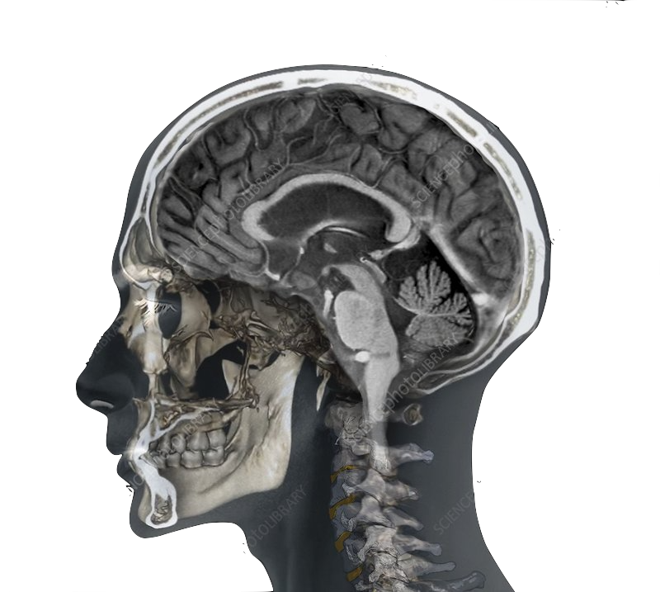
Investigation of Deep Learning Dose Prediction Robustness for MR Guided Radiotherapy
Simon Gutwein
Tübingen- 29.11.2021
Master – Thesis
Notes:
welcome
topic is quite large im going over some slides fairly quickly
if you have any questions feel free to ask them at the end of my presentation

Slide 2
Radiotherapy
Ionizing radiation causes biological damage to cells
Cancerous cells have down regulated repair mechanisms
AIM of RT: Irradiate cancerous cells, spare healthy tissue
SOLUTION: Individualized therapy planning
Notes:
induce biological damage in tumor cells while minimizing bad side effects in healhty tissue
make use of the reduce repair mechanisms in cancerous cells
achieved by. indivudialized radiotherapy

Slide 3
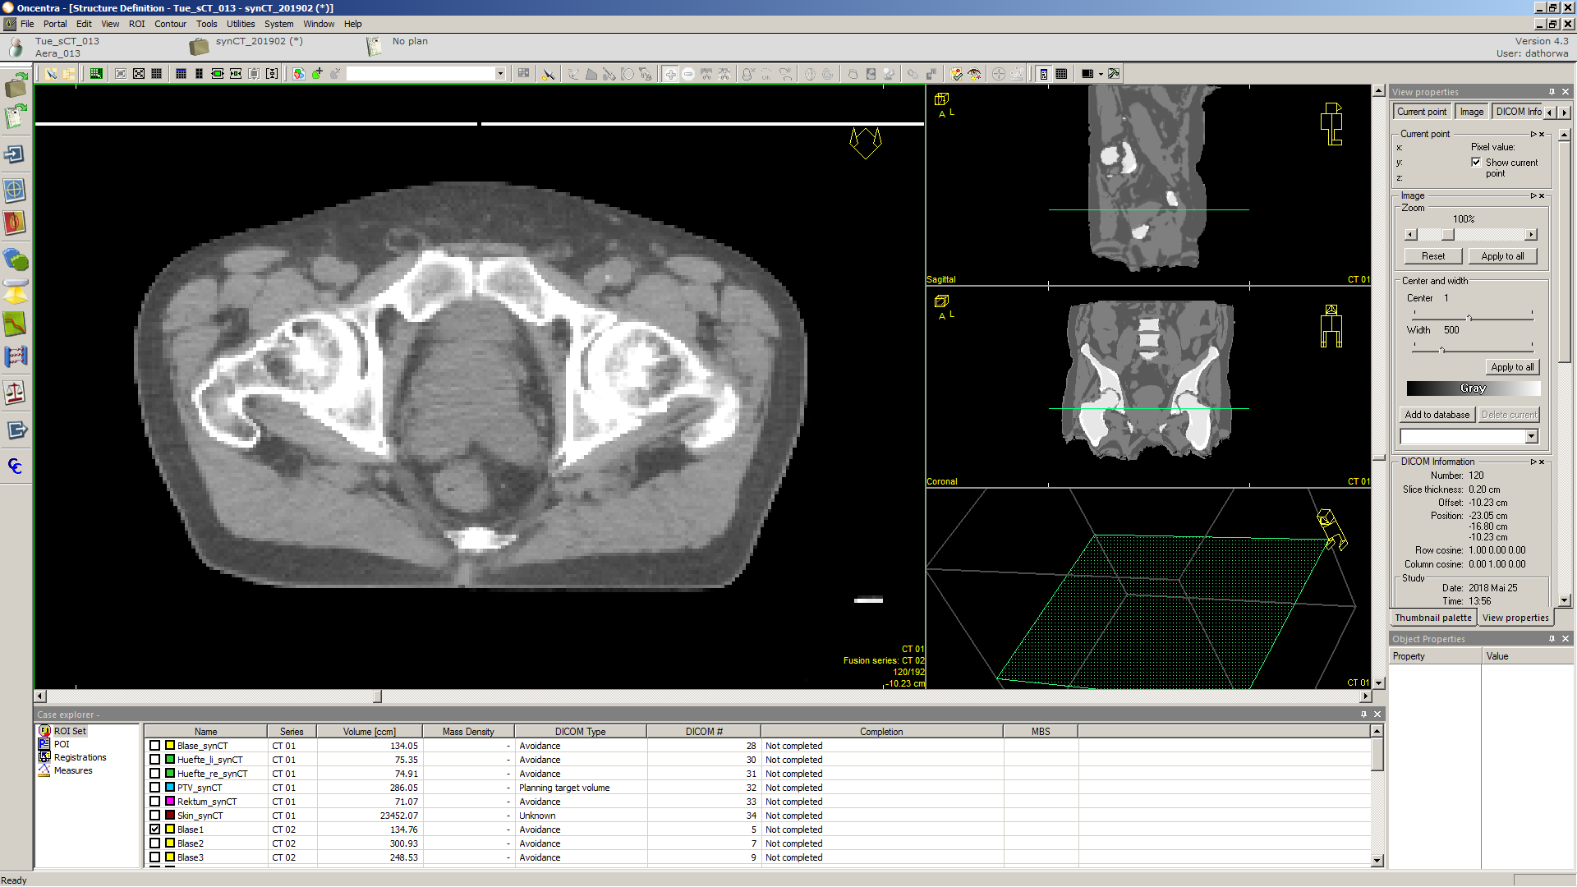
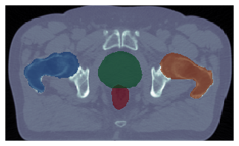
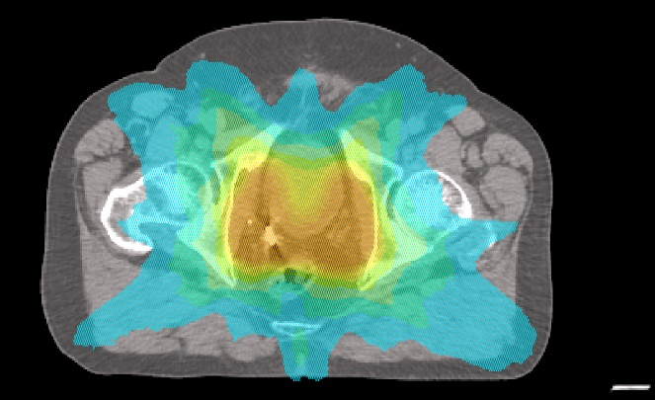
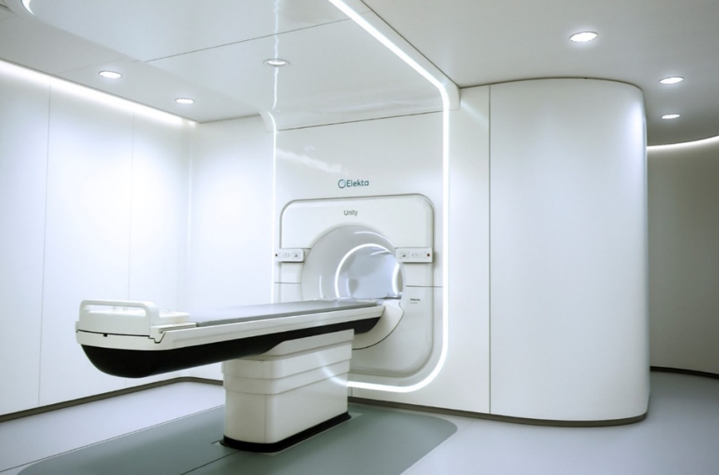
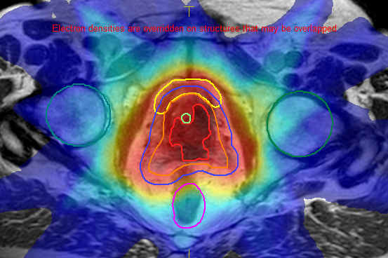
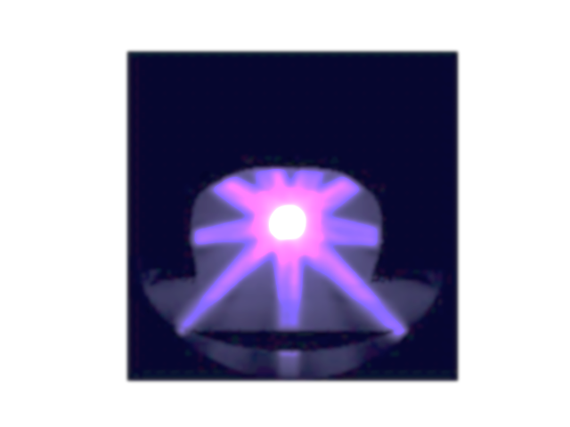
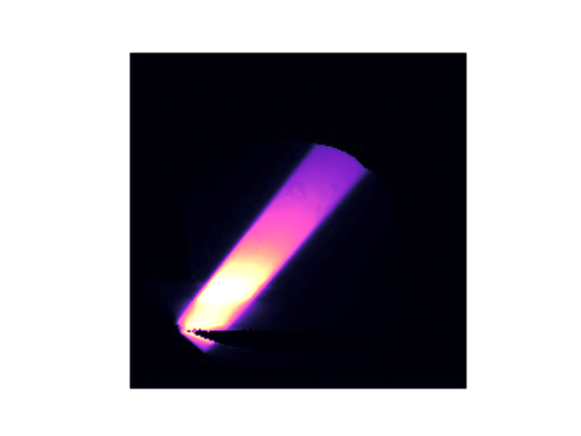
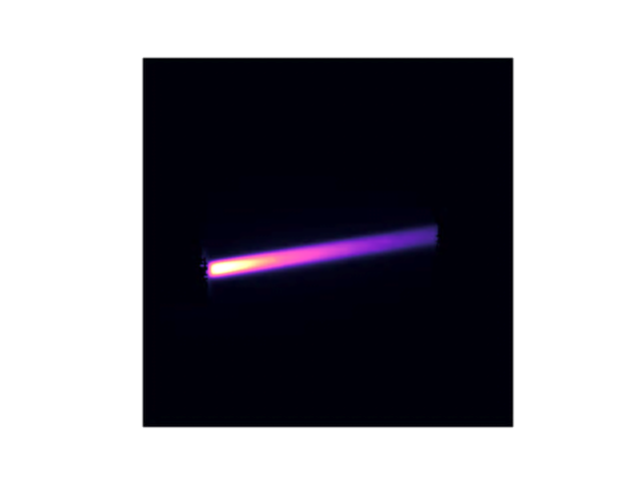
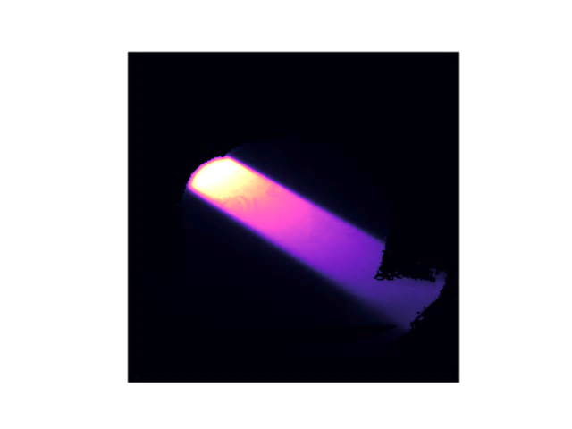
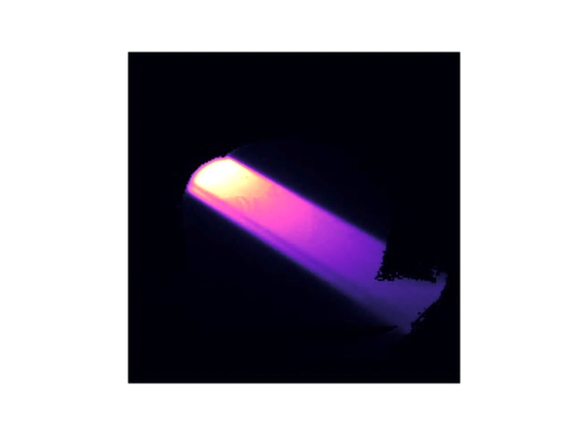
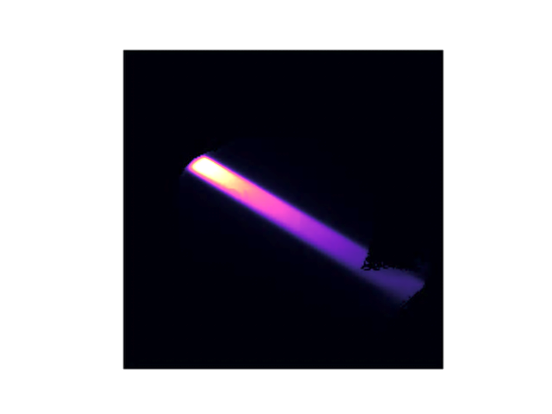
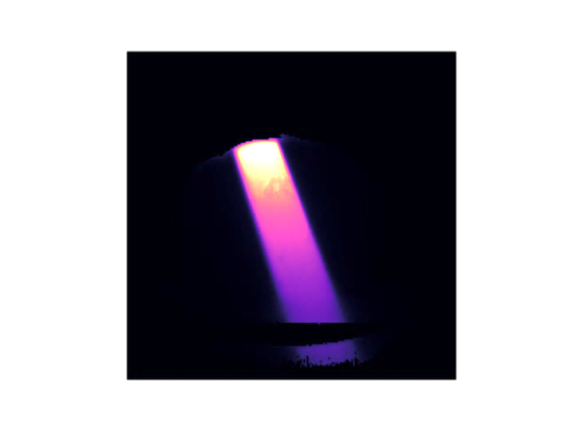
Radiotherapy Treatment Planning
individualized for each patient
CT aquisition
segmentation
planning, dose calculation
treatment
approx. 1 week
Segments
add up to
Composed of: field shape, radiation angle and count (MU)
Notes:
divided in 4 main steps

Slide 4
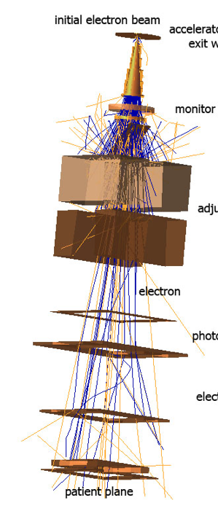
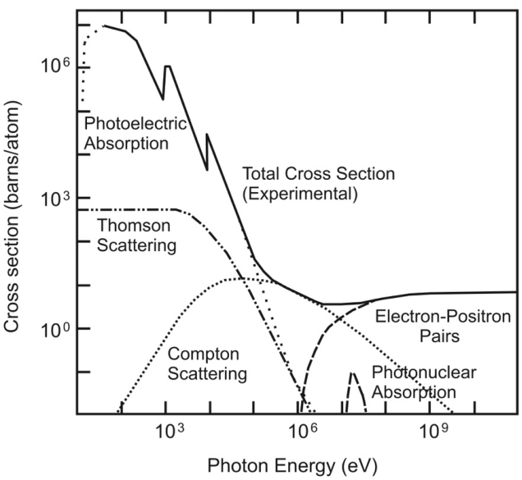
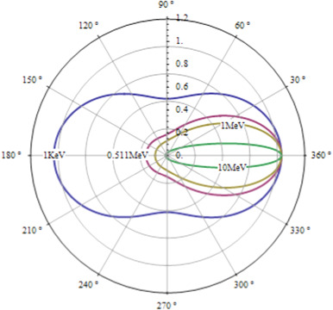
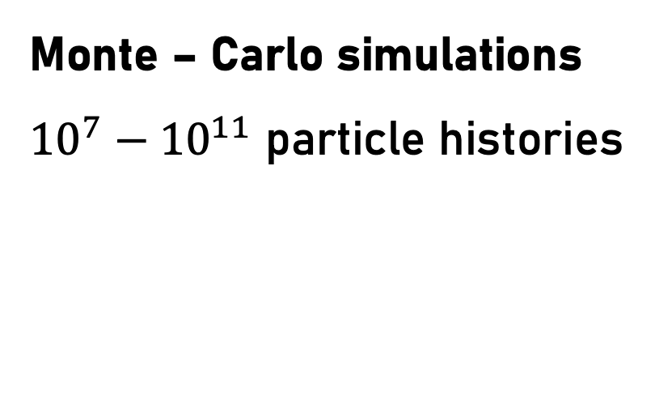
Dose Calculation
stochastic particle interactions
initial beam
[3]
[1]
[2]
field forming
photons
and electrons
Monte – Carlo simulations
${10}^{7}−{10}^{11}$ particle histories
radiated
volume
EGSnrc – DOSXYZnrc
[4]

Slide 5
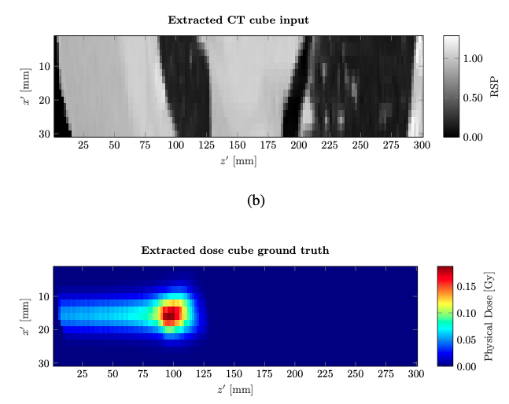
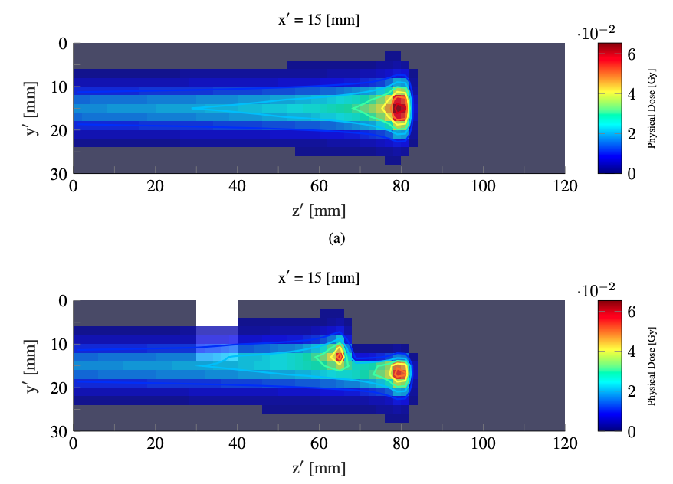
Related Work – Neishabouri et al. [5]
Long short-term memory (LSTM)
Consecutive prediction of 2D slices
Artificial Training data
Artifical cases: 98.57% (1%/3mm)
Patient cases: 97.85% (1%/3mm)

Slide 6
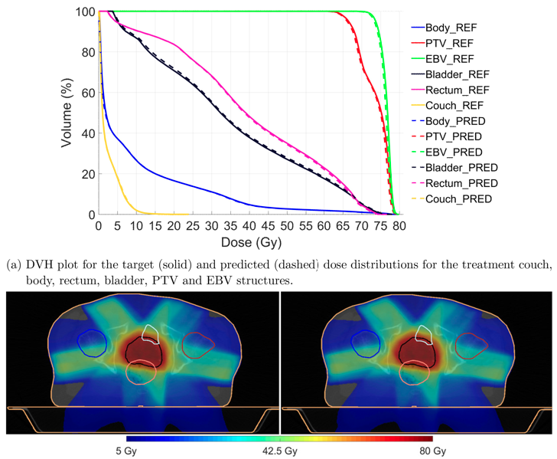
Related Work – Kontaxis et al. [6]
3D – UNet
Input: spatial information of
patient and accelerator
Prediction:
- single segments dose
- entire plan dose
- limited to lower abdomen
- passrates over 99.9%
[6]

Slide 7
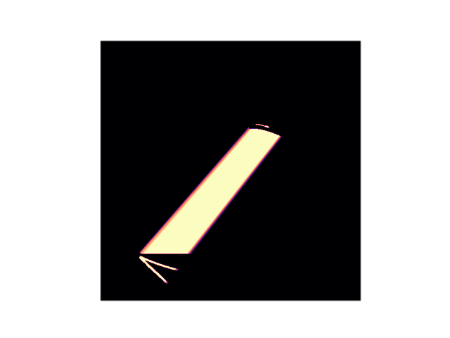
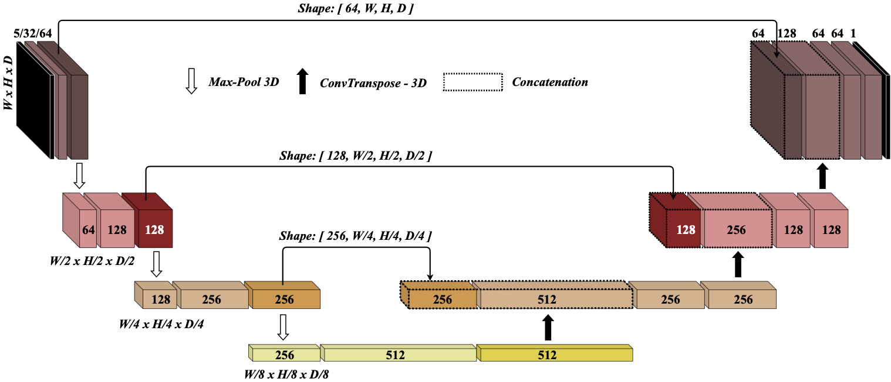
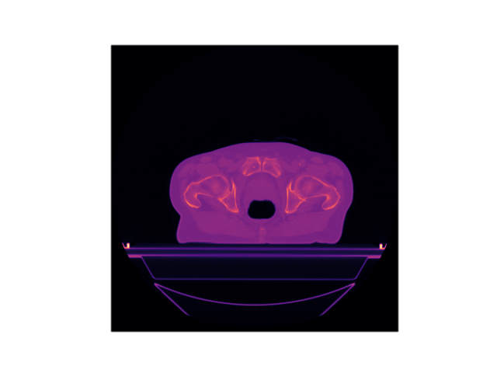
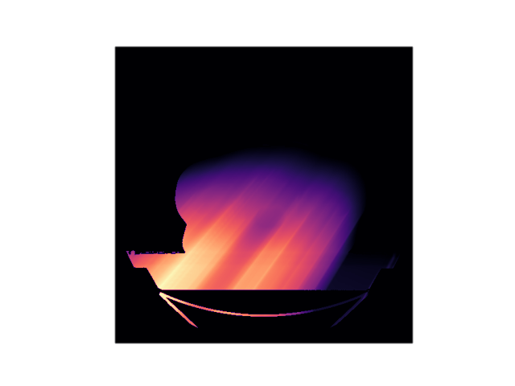


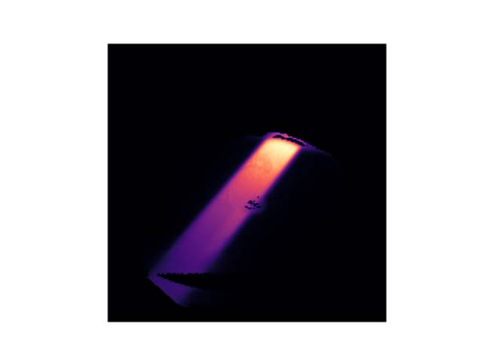
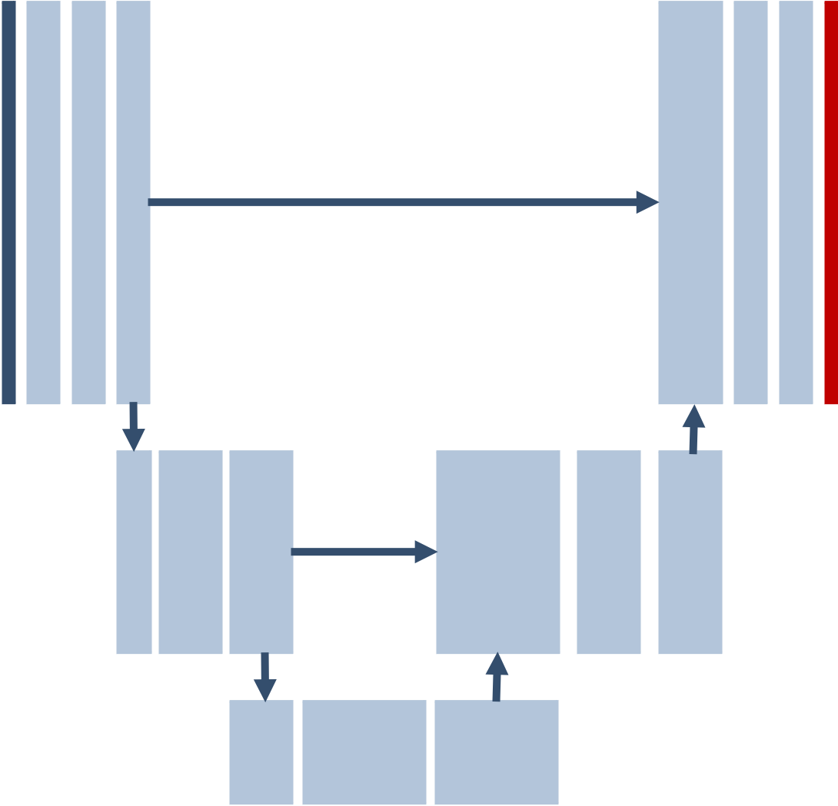
Material & Methods - Network / Training
3D-input volumes
3D-iutput volume
3D – UNET
dose distribution for:
given anatomy
given accelerator setting (segment)
Notes:
no eaasy correlation between spatial transofrmations and dose distribution
therefore no augmentation
data variability trough patch based training

Slide 8
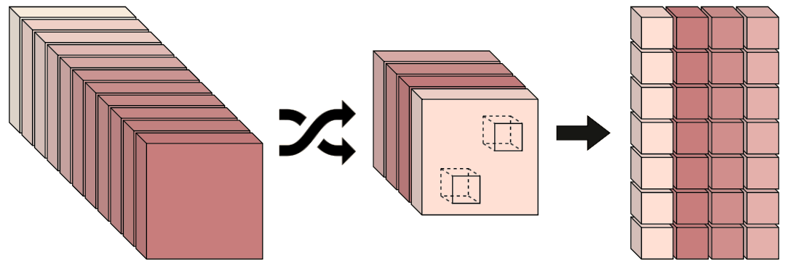
Patch Based Training
select X
segments
extract Y
patches
segment pool
selection
patches
training
p0_0
p0_1
p0_2
p0_3
. . .
pn_m
Notes:
compromise between time efficienty and data variability

Slide 9
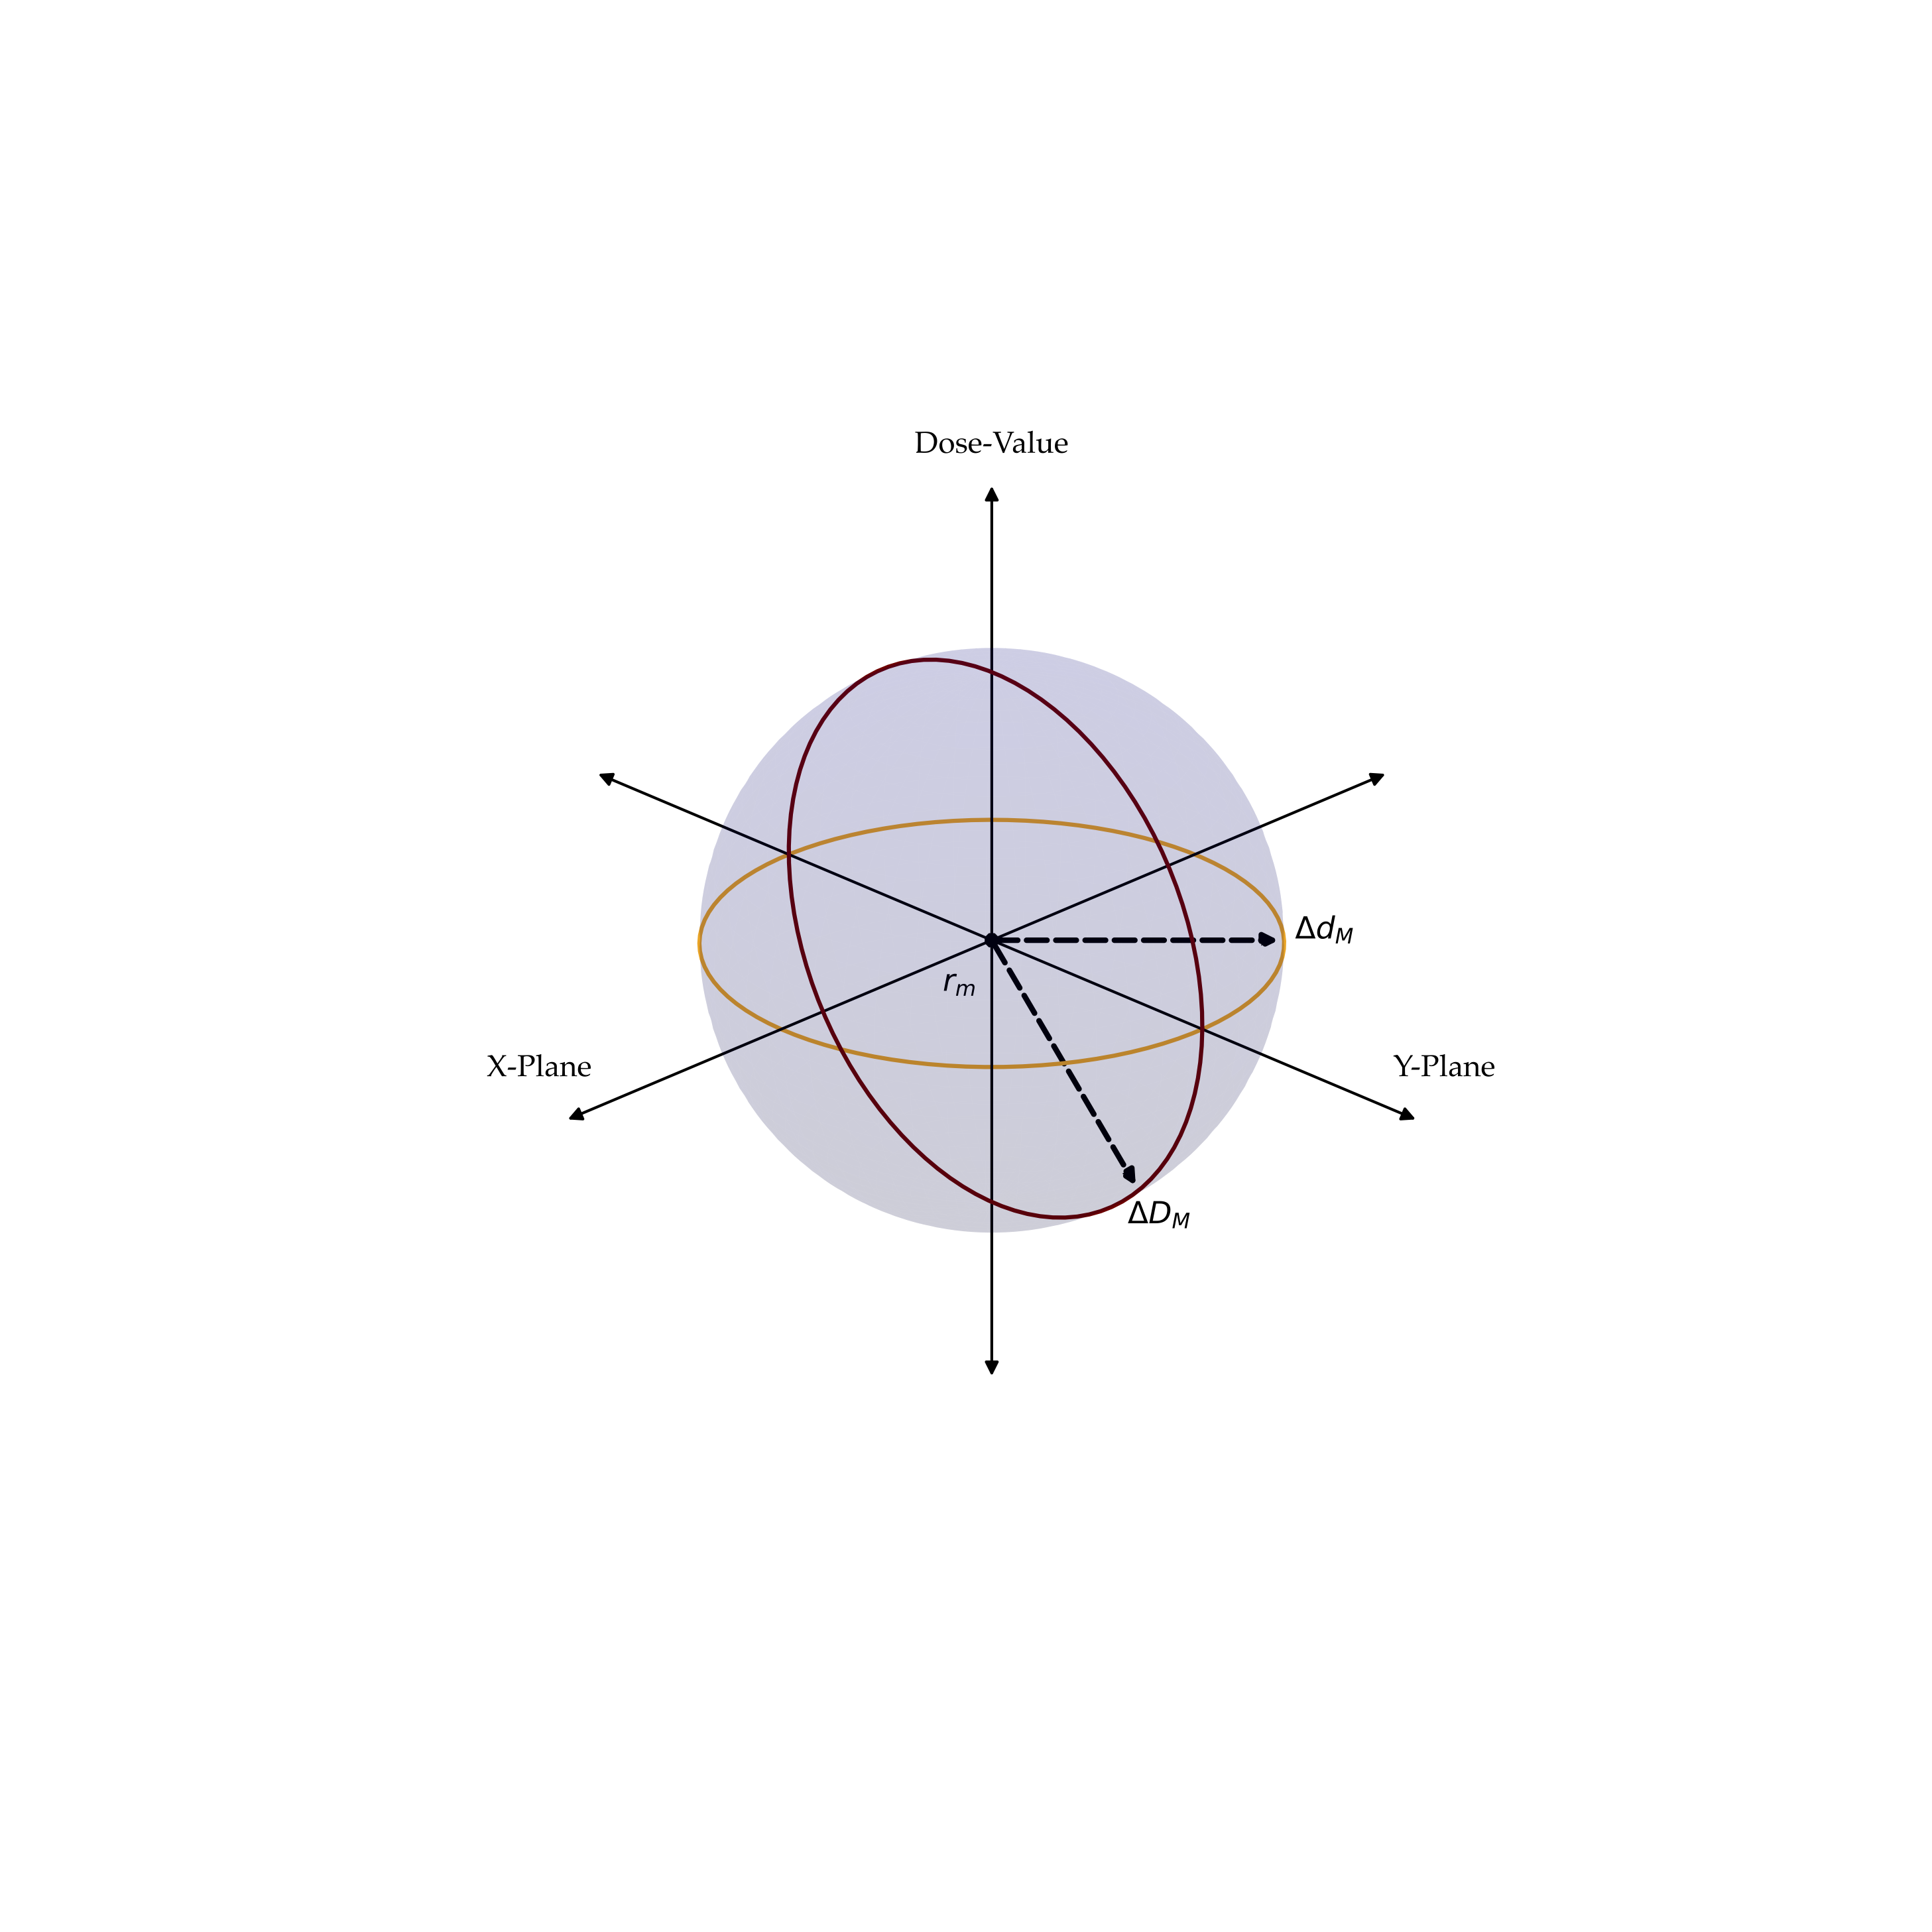
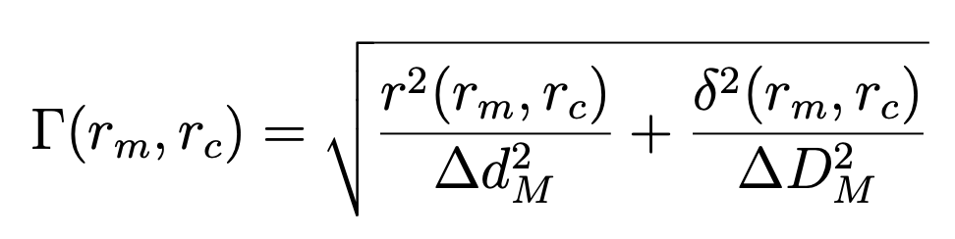
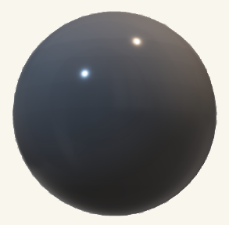
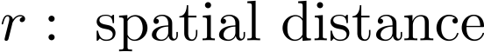
Evaluation Metrics
Gamma – Analysis [7]

Slide 10
Hypotheses – Experiments – Results
General applicability
DL for dose prediction on a signle entity yields accurate results
Poor Translatability
Model from 1. translates poorly to other body regions
Increased Robustness
Includation of varying tumor sites into training improves performance
Underlying Physics
Model is able to learn underlying physical processes
Notes:
liver bresat h&n lymphnodes
physics, eingehen darauf wie wir das getestet haben, also phantom erklären

Slide 11
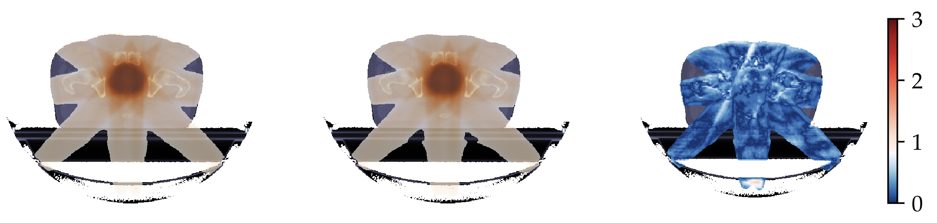
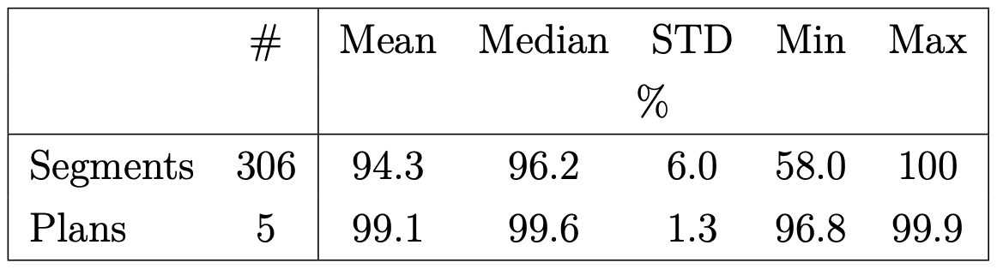
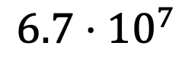
Results - General Applicability
training took ~11 days on 4 GPU
patches until convergence
Gamma analysis results:
target dose
$$6.7⋅{10}^{7}$$
predicted dose
gamma map

Slide 12
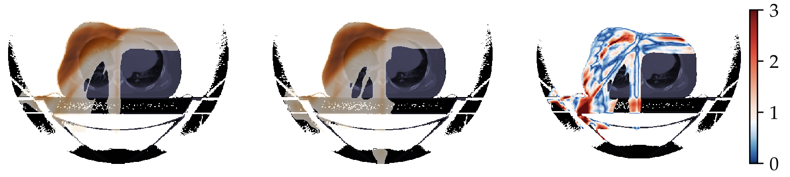
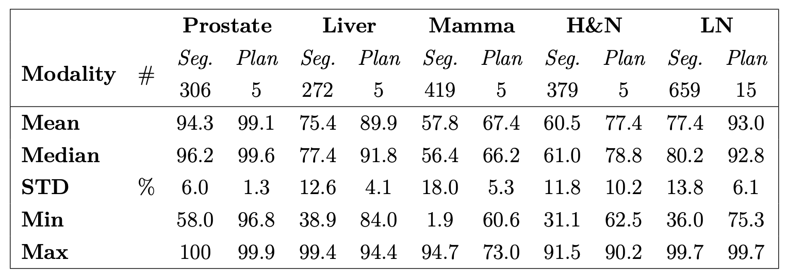
Results - Poor Translatability
target dose
predicted dose
gamma map

Slide 13
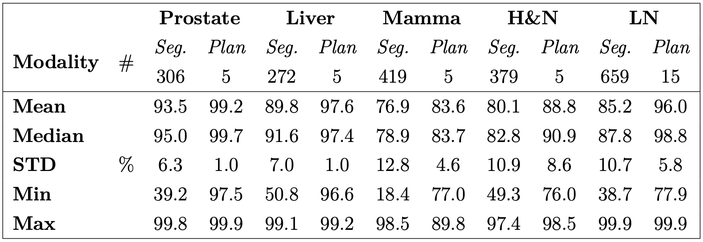
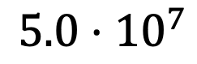
Results - Increased Robustness
training took ~9 days on 4 GPU
patches until convergence
$$5.0⋅{10}^{7}$$

Slide 14
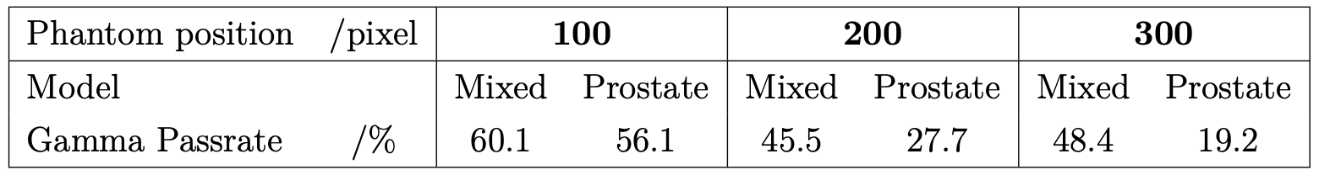
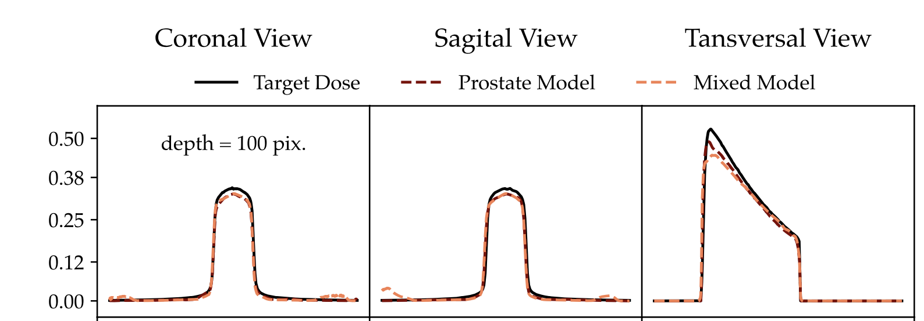
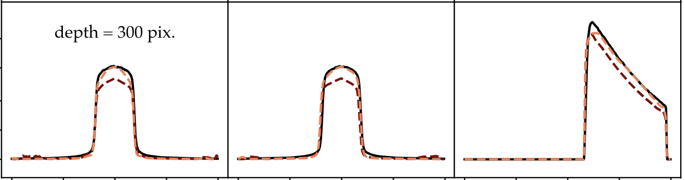
Results - Underlying Physics

Slide 15
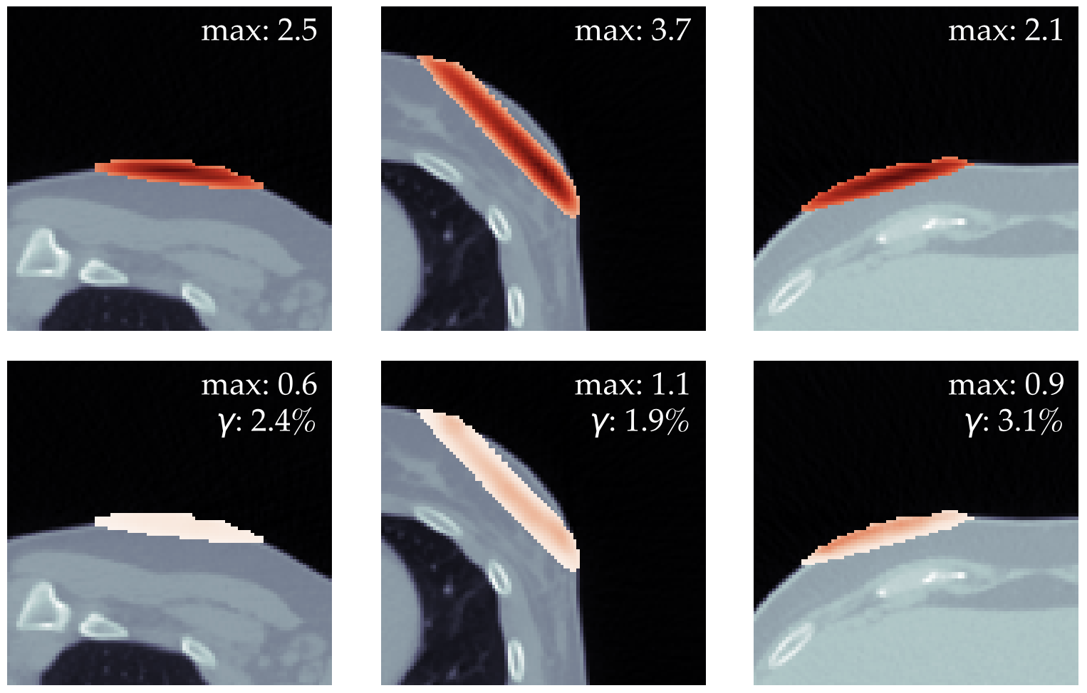
Discussion – Single Entity Training
Very good dose conformality
94.4% ± 6.0% for segments
99.1% ± 1.3% for plans
Poor accuracy on unseed body regions
Especially bad for small tangential fields
Increased variety in beam angles
Smaller voxel dimensions

Slide 16
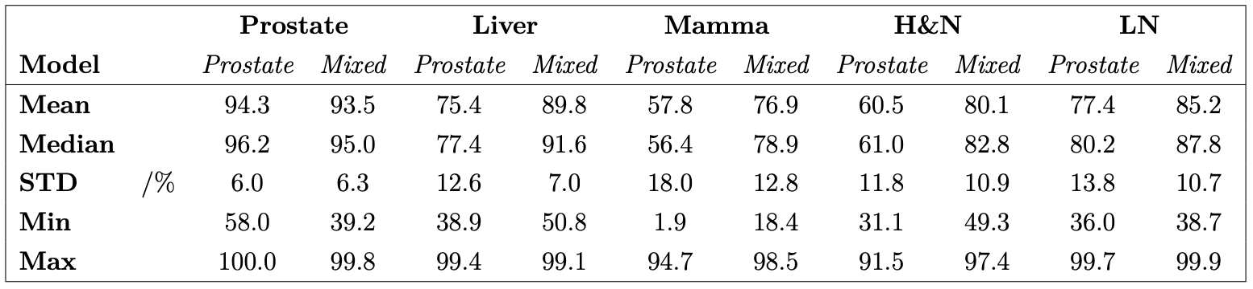
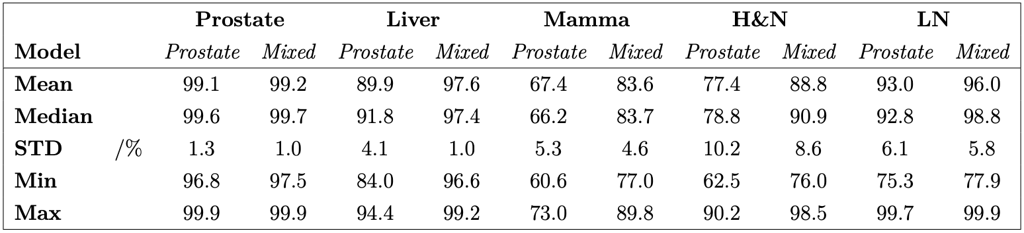
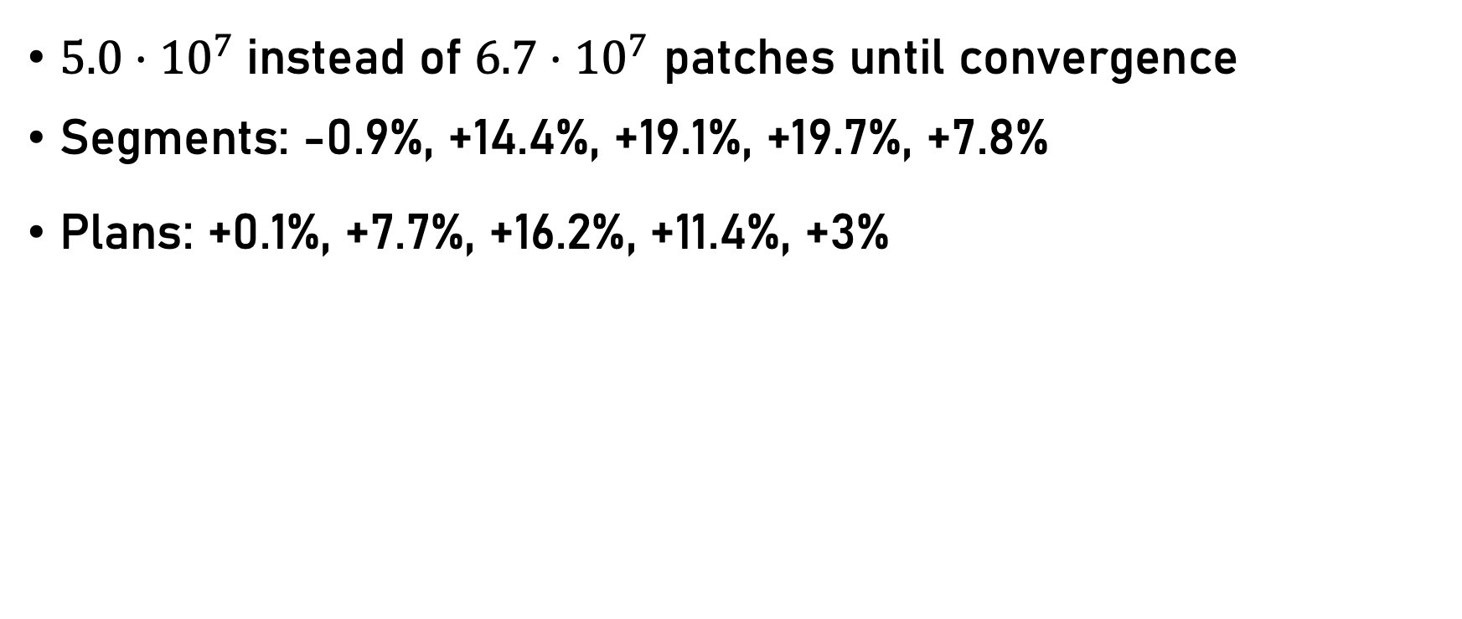
Discussion – Mixed Entity Training
$5.0⋅{10}^{7}$ instead of $6.7⋅{10}^{7}$ patches until convergence
Segments: -0.9%, +14.4%, +19.1%, +19.7%, +7.8%
Plans: +0.1%, +7.7%, +16.2%, +11.4%, +3%
segments
plans

Slide 17
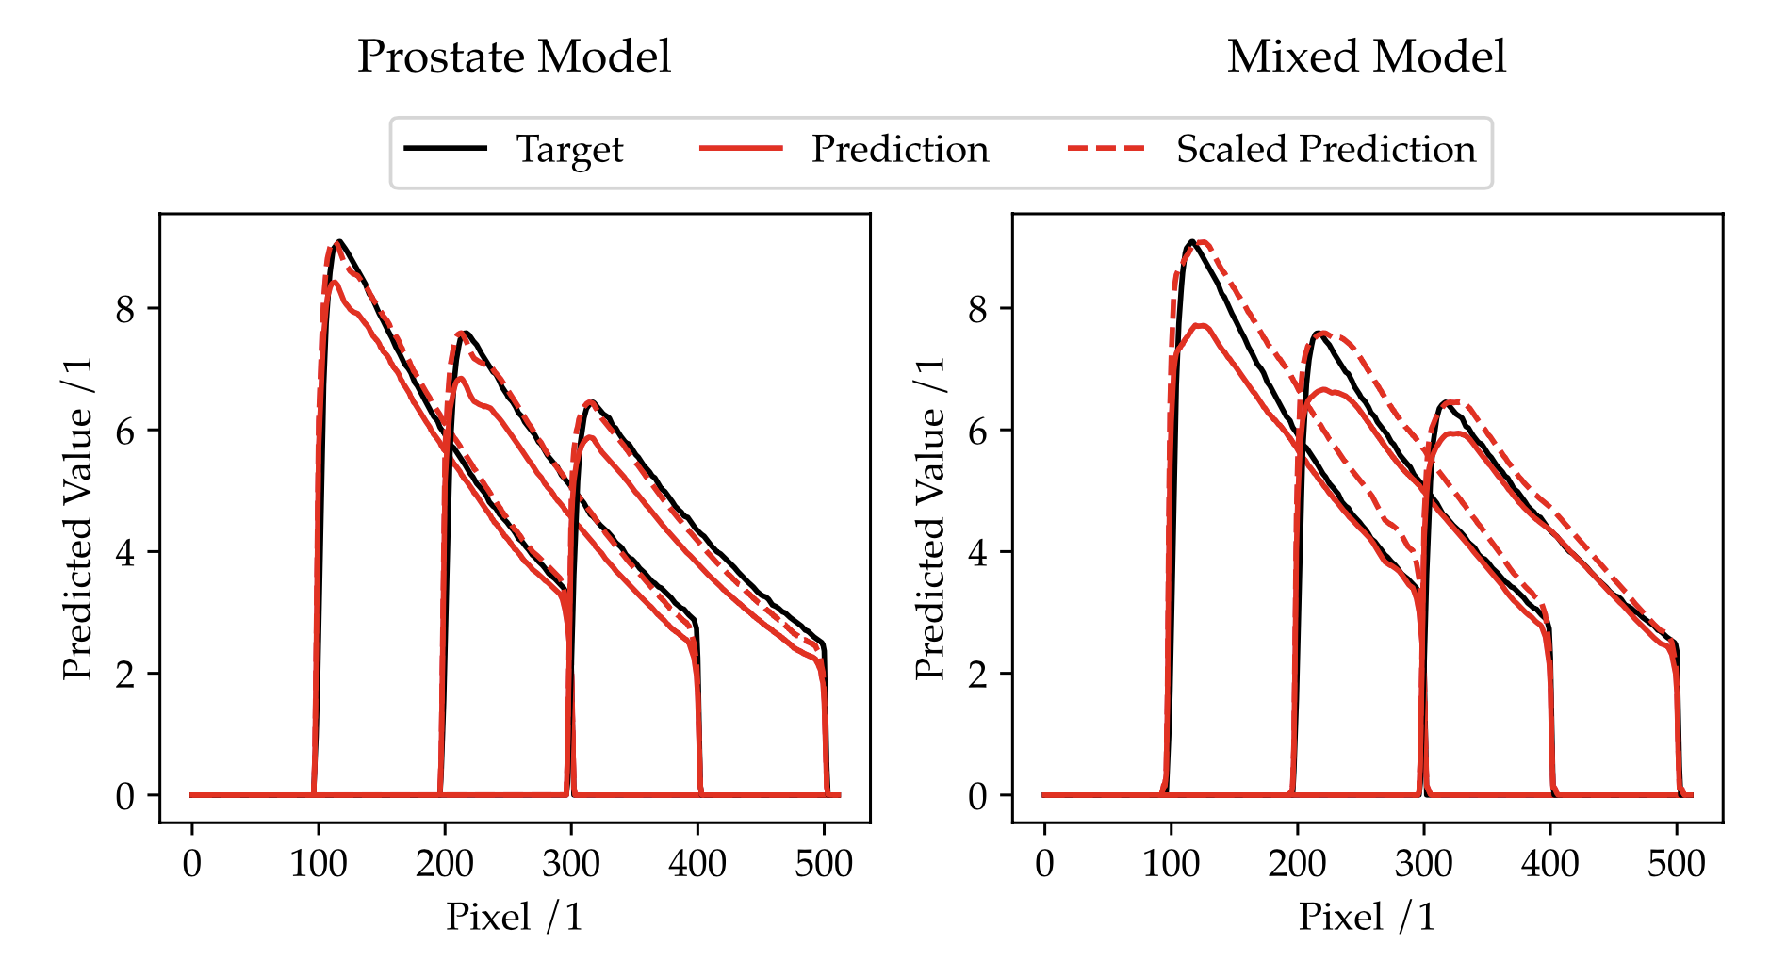
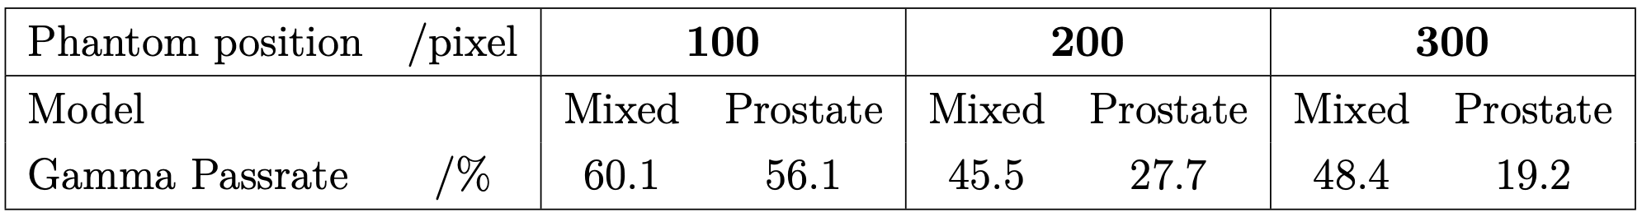
Discussion - Underlying Physics
poor accuracy regarding gamma values
increasingly bad with higher depths
mixed model
wrong peak height explains poor accuracy on tangential breast segments
latter curvate better on mixed model
prostate model

Slide 18
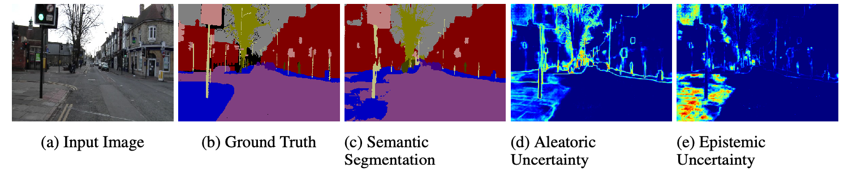
Discussion - Model Improvement
Parallelization
Memory efficient network approaches
Sequential prediction in beam direction (LSTM)
Uncertainty quantification

Slide 19
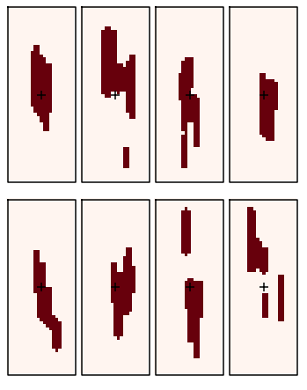
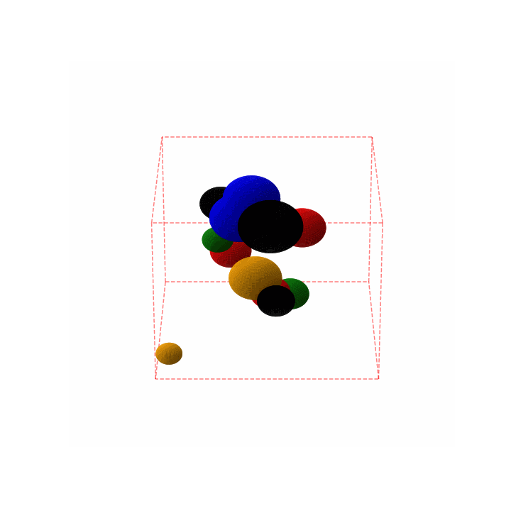
Discussion - New Training Data Approach
Deviate from patient data to artificial distributed data
Artificial Segments
Artificial Volumes

Slide 20
Literature
[1] Figure 4.1.-Photon-energy dependent cross sections. Cross sections of... [WWW Document], n.d. . ResearchGate. URL https://www.researchgate.net/figure/Photon-energy-dependent-cross-sections-Cross-sections-of-the-photoelectric-absorption_fig18_281185409 (accessed 11.24.21).
[2] Akhavan, A., Vosoughi, N., 2015. Calculation of photon pulse height distribution using deterministic and Monte Carlo methods. Radiation Physics and Chemistry 117, 160–166. https://doi.org/10.1016/j.radphyschem.2015.08.010
[3] Mihailescu, D., Borcia, C., n.d. MONTE CARLO SIMULATION OF THE ELECTRON BEAMS PRODUCED BY A LINEAR ACCELERATOR FOR INTRA- OPERATIVE RADIATION THERAPY 14.
[4] Kawrakow, I., Mainegra-Hing, E., Rogers, D.W.O., Tessier, F., Walters, B.R.B., n.d. Monte Carlo Simulation of Electron and Photon Transport 323.
[5] Neishabouri, A., Wahl, N., Mairani, A., Köthe, U., Bangert, M., 2021. Long short‐term memory networks for proton dose calculation in highly heterogeneous tissues. Med. Phys. mp.14658. https://doi.org/10.1002/mp.14658
[6[ Kontaxis, C., Bol, G.H., Lagendijk, J.J.W., Raaymakers, B.W., 2020. DeepDose: Towards a fast dose calculation engine for radiation therapy using deep learning. Phys. Med. Biol. 65, 075013. https://doi.org/10.1088/1361-6560/ab7630
[7] Low, D.A., Harms, W.B., Mutic, S., Purdy, J.A., 1998. A technique for the quantitative evaluation of dose distributions. Med. Phys. 25, 656–661. https://doi.org/10.1118/1.598248

Slide 21
Thank you for your attention and interest
Notes:
I hope you found it interesting and i would like to thank you for your attention and if you have any questions feel free to ask them now

Slide 22
Appendix
segments
plans

Slide 23

Appendix

Slide 24


